Slide 1
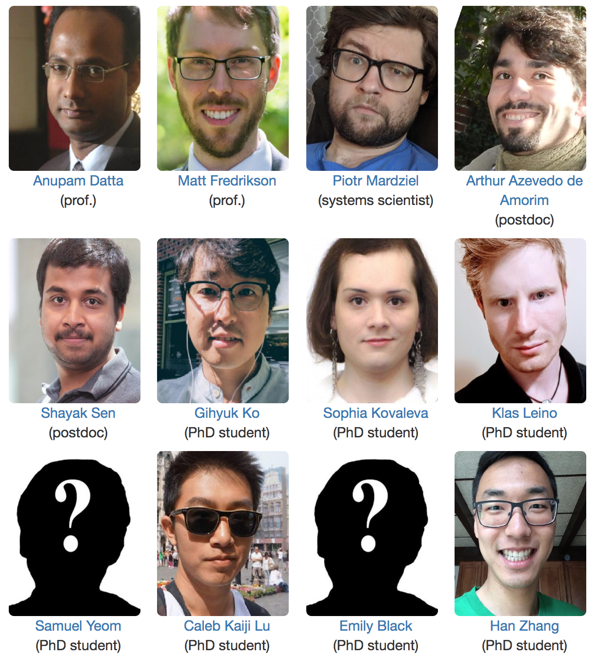

Accountable Deep Learning
Piotr (Peter) Mardziel
Accountable Systems Lab
fairlyaccountable.org
@ Silicon Valley (rest @ Pittsburgh)

Slide 2
Machine Learning
A basic machine learning before and after diagram.
past: humans understand system and offer a solution
now: computers process data and construct an artifact / model

Slide 3
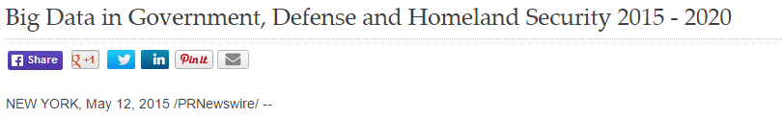
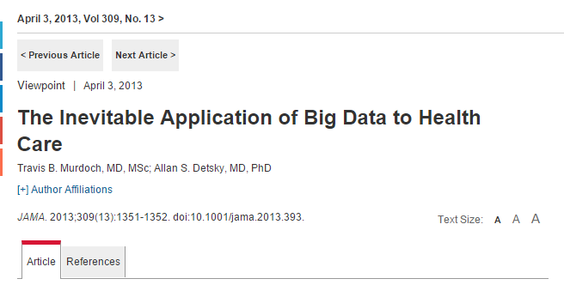
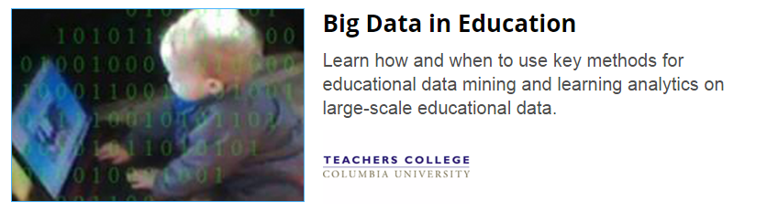


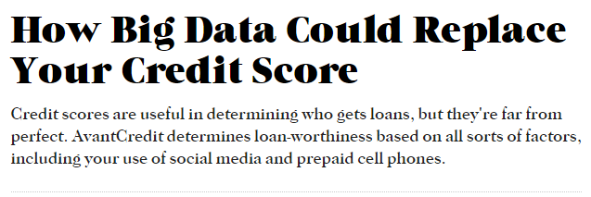
Machine Learning Systems are Ubiquitous
Notes:
Automated data-driven systems that employ machine learning and other artificial intelligence technologies increasingly make decisions that affect our lives.
Which loan or job applications should be approved? How likely is a criminal offender to commit another crime? Does a set of medical images indicate that an individual has cancer? Which advertisements and recommendations should be shown to people as they interact in the digital and physical world?

Slide 4
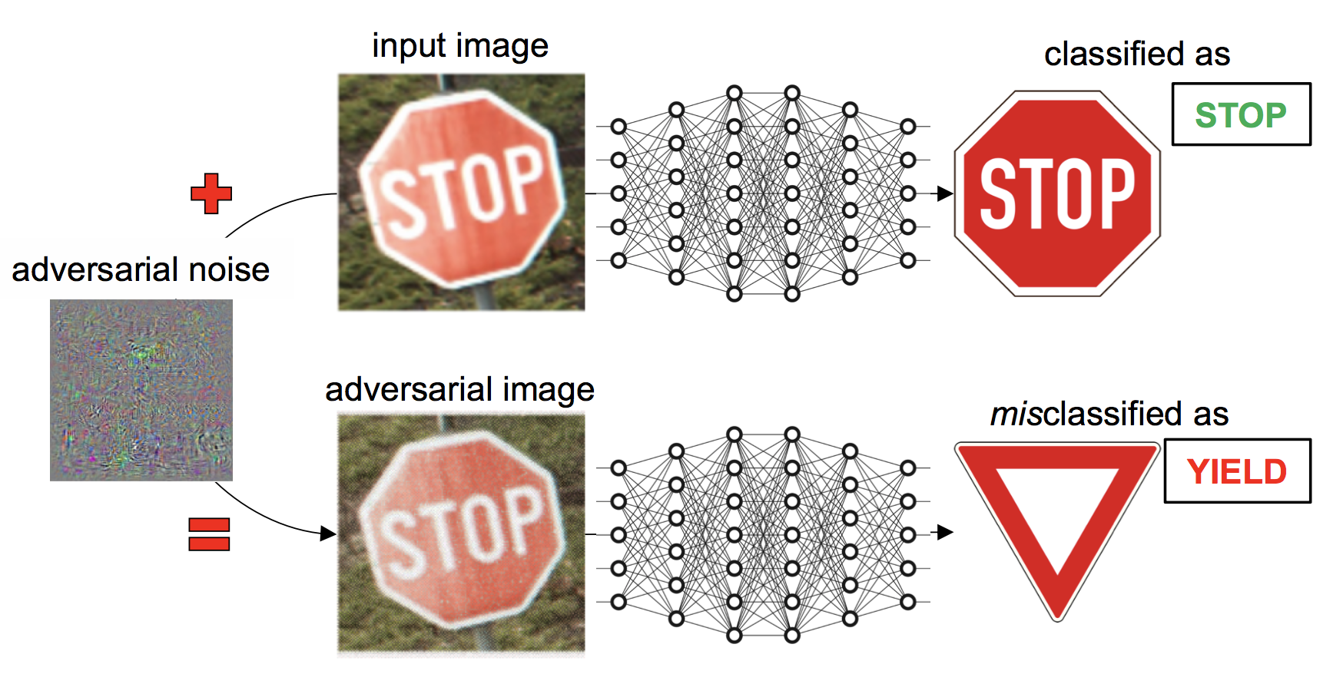
What can go wrong?
Bugs
Model incorporates inconsequential inputs
Privacy
Model infers sensitive information and uses it
Discrimination
Model makes use of protected class for restricted purposes
Compliance with regulations
US ECOA, HIPAA; EU GDPR

Slide 5
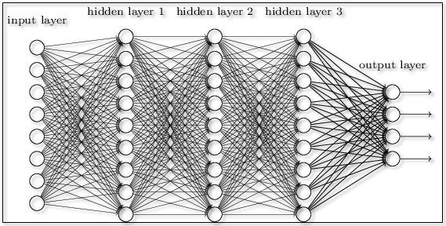
Deep Learning
Basics of deep learning.
Artifact / model is particularly opaque
Inputs may not be understandable in isolation
Example application areas.
Translation / other NLP
Speech recognition
Vision
object classification
healthcare
self driving cars

Slide 6
Current Projects
Project 1: Debiasing neural natural language processing systems
“Man is to programmer as woman is to home-maker.”
Project 2: Conditional debiasing in neural networks
Cannot use age for credit decisions unless justified by business necessity.
Project 3: Explaining neural networks
Why did the network classify this image as a convertible car?
other projects

Slide 7
Project 1: Debiasing NLP [Lu, Mardziel, Datta]
Man is to programmer as woman is to homemaker.

Slide 8
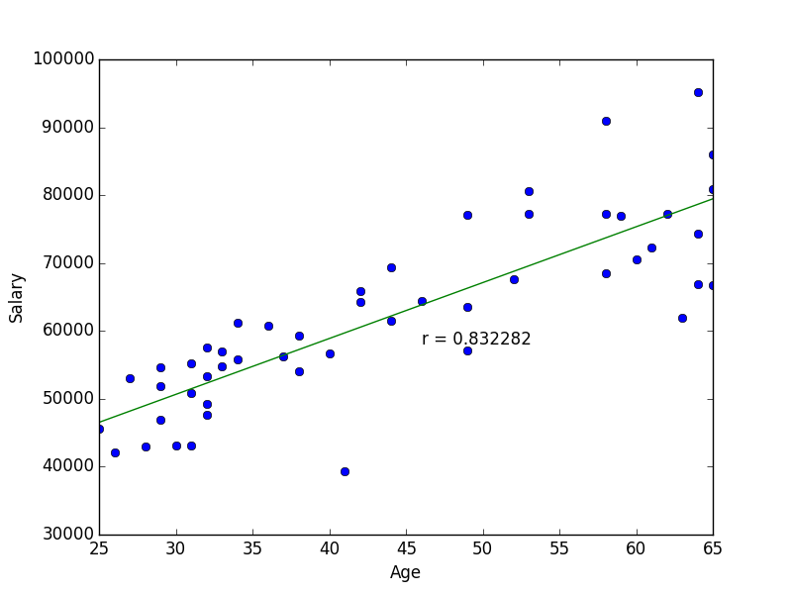
Project 2: Conditional debiasing [Kovaleva, Mardziel, Datta]
Age cannot be used to make credit decisions.
Problem: age can be used even if it is not explicitly an input.
Can be inferred from explicit inputs.

Slide 9
Project 3: Explaining deep networks [Leino, Sen, Li, Datta, Fredrikson]
Identify causally influential neurons in internal layers
Give them interpretation using visualization techniques

Slide 10
Why classified as sports car instead of convertible?
VGG16 ImageNet model
Input image
Influence-directed Explanation
Uncovers high-level concepts that generalize across input instances
Notes:
Images of cars labeled “sports car” by VGG16 ImageNet
model (a) and receptive fields of the most influential feature map
on a comparative quantity that characterizes the model’s tendency
to predict “sports car” over “convertible” (b). In most cases, the
features within the field contain the top of the car, which is the key
distinctive concept between these classes.

Slide 11
Vision: Explainable Machine Learning Systems
Reveal “meaningful information about the logic” of the machine learnt prediction/decision model
Enable humans + machines to make better decisions together
Build trust in and debug models
Guard against societal harms, e.g. unfairness
Comply with regulations , e.g. EU GDPR, US ECOA
Applications: Finance, healthcare, security, cyber-physical systems

Slide 12

Piotr (Peter): piotrm@cmu.edu
Anupam: danupam@cmu.edu
Accountable Systems Lab
fairlyaccountable.org
@ Silicon Valley (rest @ Pittsburgh)

